Slide 1


Sap ABAP on Hana &
s/4hana trainings
Anubhav Oberoy

Slide 2

INTRODUCTION

Slide 3
Agenda – Day 9
Create Fiori App with annotation File on Top of CDS
Describing Details about Idoc
Create your OVP ( Overview page ) UX Elements show Analytical dashboard
--Break--
Describing SAP Analytics Cloud ( SAC )
Consume CDS in Analytics Cloud
Creating Dashboard’s on top of CDS in Analytics Cloud

Slide 4

End to End Flow of Creating Fiori App
Fiori App Development – Fiori Developer
After Creating CDS View we start SAP Business Application Studio
We Create a Fiori App, Choose Find Command → Fiori : Application Generator
Choose Free Style Fiori app, Enter the App name and the view name
Choose Radio Button Add Deployment Configuration to Yes
Go to view->Main.view.xml, Refer SAPUI5 sdk and create smart filter, smart table and a tree table control
Go to manifest.json and link a new annotation file
Create the annotation file with lineItem annotation to add columns to our table
Go to Run configuration and test the fiori app by connecting to the destination and UI5

Slide 5
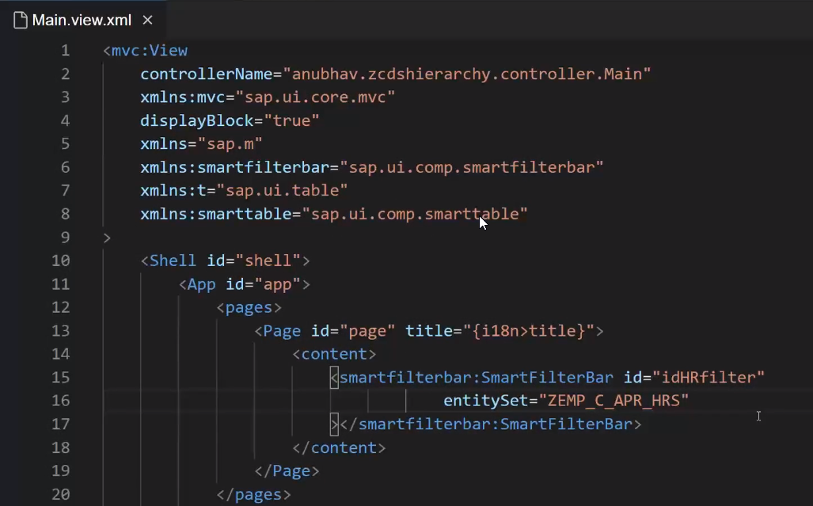
Creating Fiori app on top of CDS

Slide 6

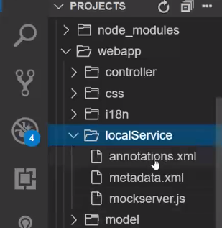
Creating Annotation File
Annotataion file

Slide 7
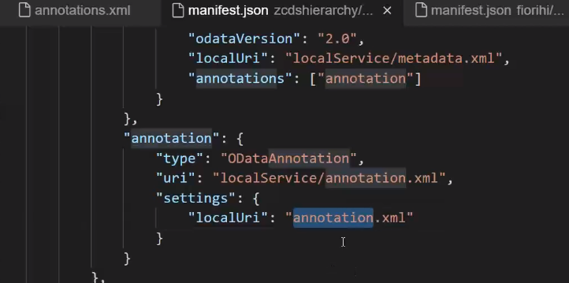
Linking of Annotation File
Link annotation file use this code in Manifest.json

Slide 8
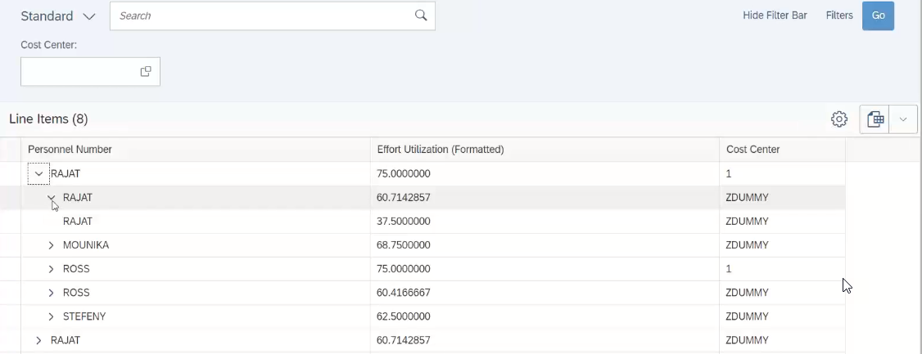
Result Employee Manager Hierarchy
Notes:
The sole purpose of an R/3 system is to provide a suite of tightly integrated, large-scale business applications. R/3 comes prepackaged with the core business applications needed by most large corporations. These applications coexist in one homogenous environment. They are designed from the ground up to run using a single database and one (very large) set of tables.
Presentation: It is usually installed on a user's workstation. When started, the presentation server displays the R/3 menus within a window. This window is commonly known as the SAPGUI, or the user interface (or simply, the interface).
Basis : Basis is like an operating system for R/3. It sits between the ABAP/4 code and the computer's operating system. SAP likes to call it middleware because it sits in the middle, between ABAP/4 and the operating system. ABAP/4 cannot run directly on an operating system. It requires a set of programs (collectively called Basis) to load, interpret, and buffer its input and output. Basis provides the runtime environment for ABAP/4 programs.
Database: The database server is a set of executables that accept database requests from the application server. These requests are passed on to the RDBMS (Relation Database Management System). The RDBMS sends the data back to the database server, which then passes the information back to the application server. The application server in turn passes that information to your ABAP/4 program.

Slide 9
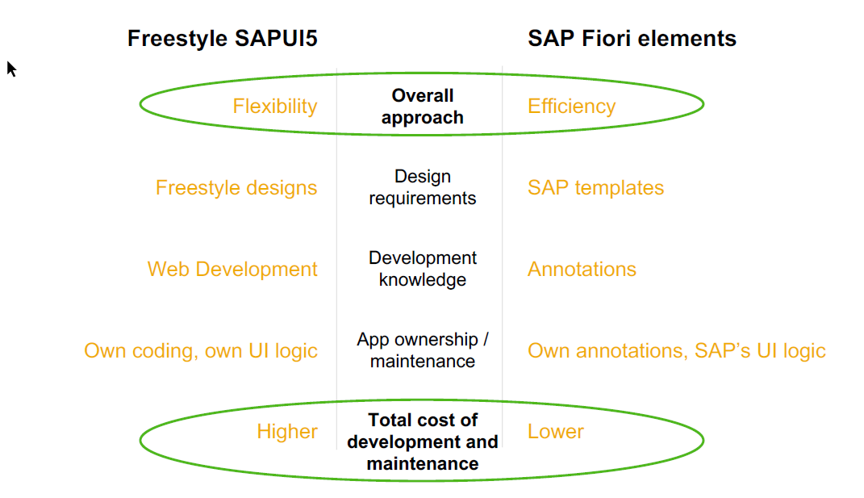
When to go Free style v/s Fiori Element

Slide 10
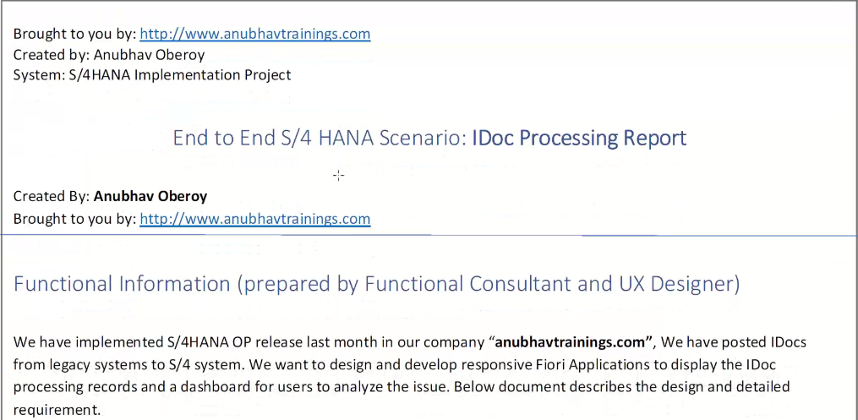
End to End Idoc Reporting
IDoc, short for Intermediate Document, is a SAP document format for business transaction data transfers. Non SAP-systems can use IDocs as the standard interface (computing) for data transfer. IDoc is similar to XML in purpose, but differs in syntax.

Slide 11
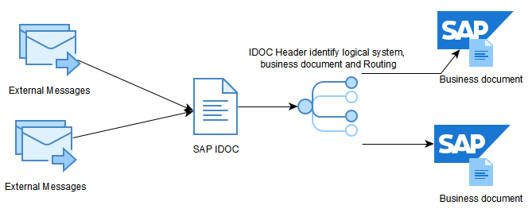
Concept of Idoc

Slide 12
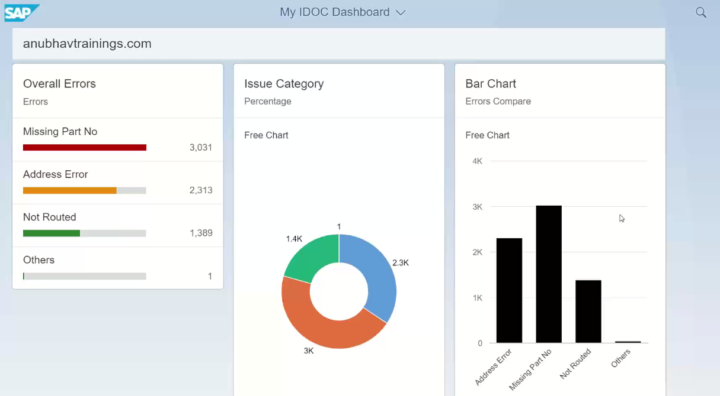
Analytic Dashboard

Slide 13

Break

Slide 14
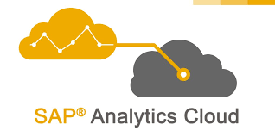
SAP Analytics Cloud ( SAC )
The SAP Analytics Cloud solution combines BI, augmented and predictive analytics, and planning capabilities into one cloud environment. As the analytics layer of SAP's Business Technology Platform, it supports advanced analytics enterprise-wide.
SAP Analytics cloud is a SaaS offering by SAP for complete BI, Planning, Predictive and designer capabilities.

Slide 15
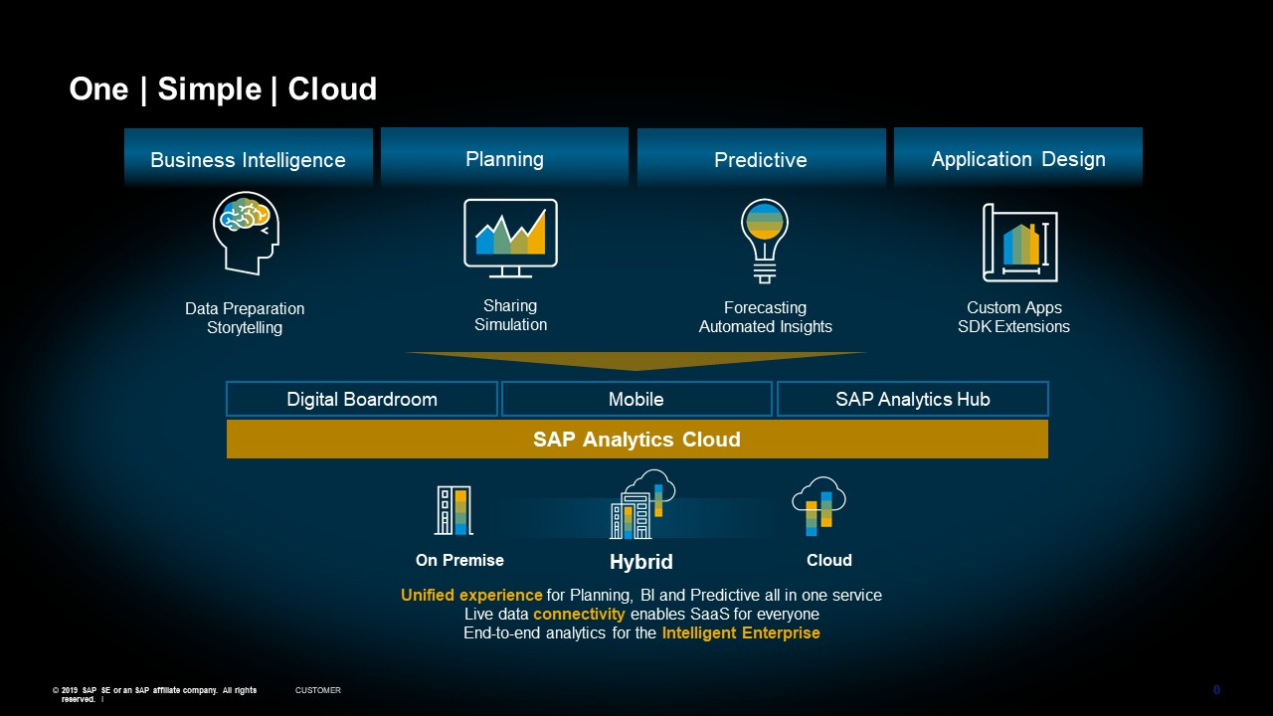
Phase of SAP Analytics Cloud ( SAC )

Slide 16
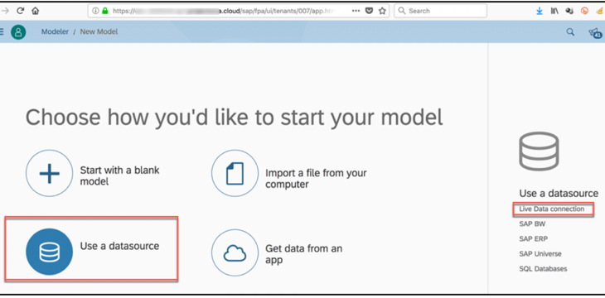
Consume CDS in Analytic Cloud
With Live Data
Connection

Slide 17
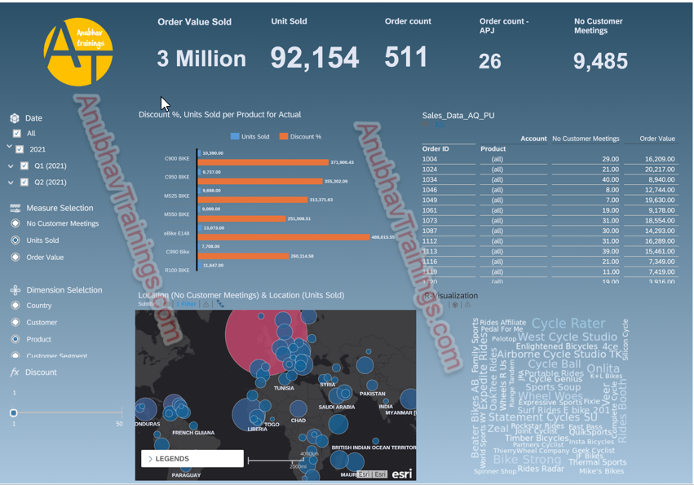
SAC Dashboard on top of CDS

Slide 18
Feedback
AnubhavTrainings.com :
https://www.anubhavtrainings.com

Slide 19
End of Day 9

Slide 20

Questions

Slide 21

Anubhav Oberoy

